Slide 1
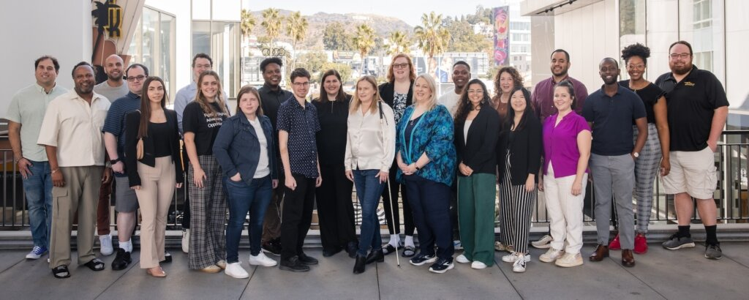
Disability 101: Disability in the Criminal Legal System
NACDL | February 29, 2024

Slide 2
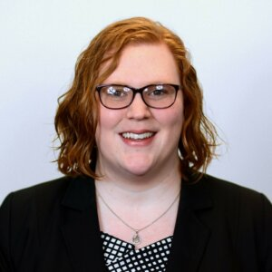
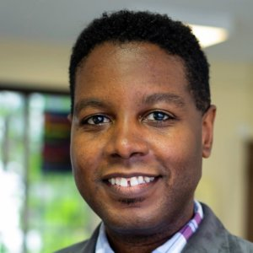
Today’s Facilitators
Ariel Simms (they/she), President & CEO at RespectAbility
Graciano Petersen (he/him), Senior Director of Talent, Culture and Training at RespectAbility

Slide 3
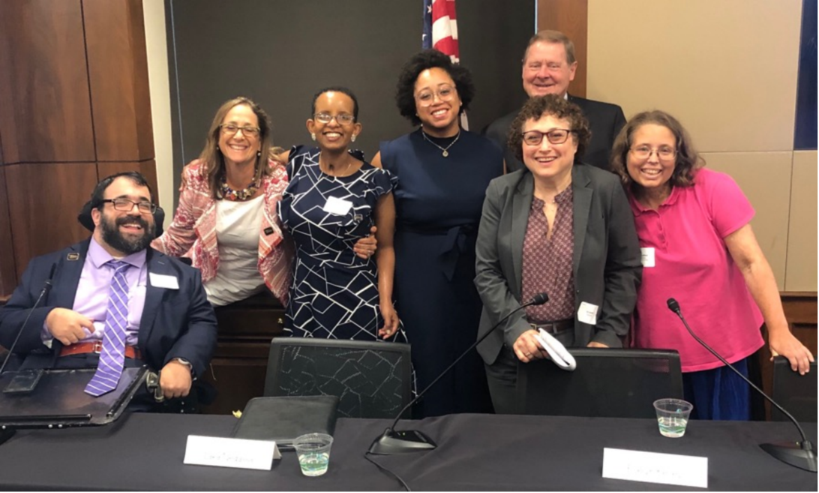
Who We Are
RespectAbility is a diverse, disability-led nonprofit. Our mission is to fight stigmas and advance opportunities so people with disabilities can fully participate in all aspects of community.

Slide 4
Today’s Learning Objectives
By the end of the session, legal professionals will be able to:
Explain the concept of disability, including both legal definitions of disability as well as disability as an intersectional identity
Utilize language and terminology generally preferred by those with disabilities, as well as the broader disability advocacy movement
Describe highlights of the disability advocacy movement and disability rights landscape in the United States
Articulate the basic rights of disabled individuals participating in the criminal legal process
Implement 5 actions to support access, effective communication, and broader disability inclusion efforts, including in their office, agency, and/or firm practices
Name at least 3 resources that can support them in their work with disabled individuals and clients

Slide 5
Share in the Chat:
How would you define disability?

Slide 6
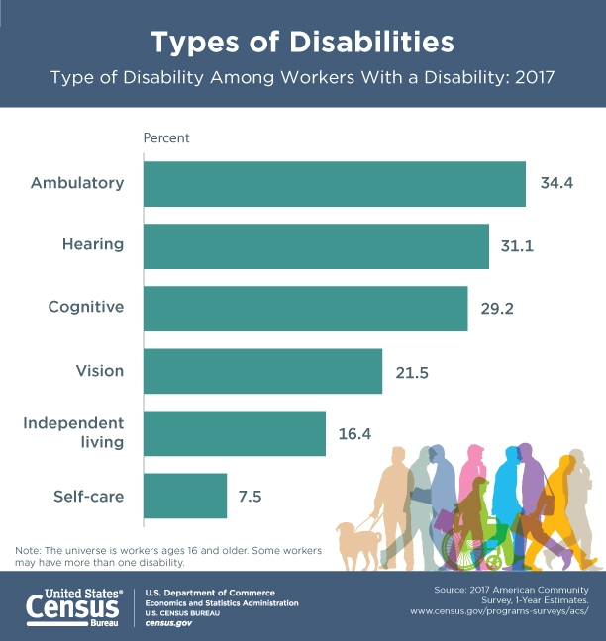
Defining Disability
The Americans with Disabilities Act (the “ADA”) defines disability as “a physical or mental impairment that substantially limits one or more major life activities.”
Major life activities include such activities as caring for oneself, performing manual tasks, walking, seeing, hearing, speaking, breathing, learning, and working.

Slide 7
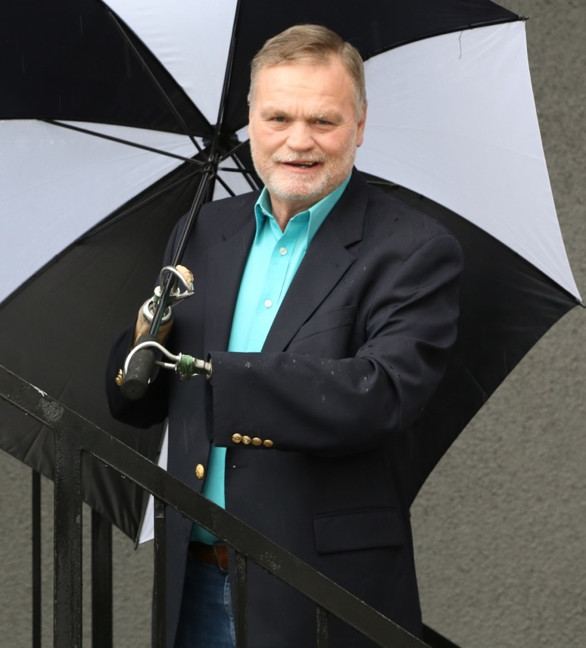
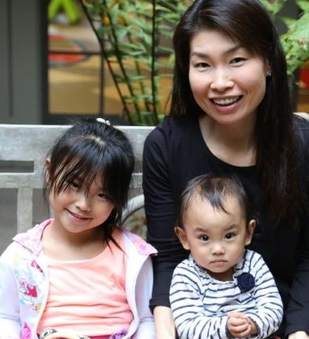
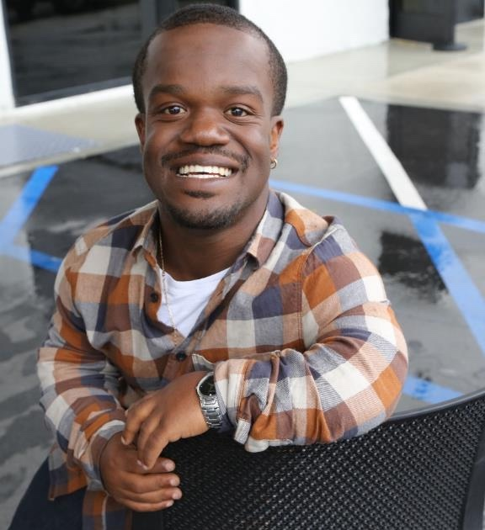
Disabilities are…
Temporary and Permanent
Apparent and Nonapparent
From Birth or Acquired Later

Slide 8
The Diversity of the Disability Community
Physical/Mobility
Sensory
Mental Health
Developmental
Age-Related
Chronic Health Conditions
Communication and Cognitive

Slide 9
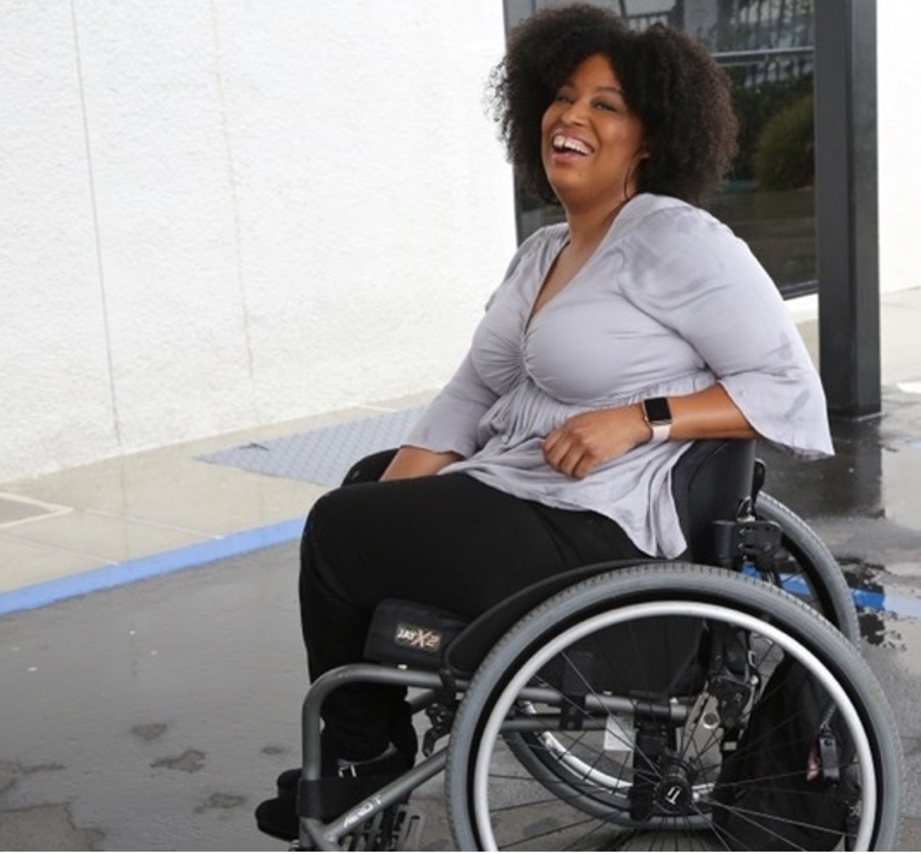
61 million people
61 million
people in the United States have a disability
1 in 4
adults have a disability
(physical, sensory, cognitive, mental health or other)
*Source: U.S. Census

Slide 10
Models of Disability
Charity/pity
Medical/functional limitation
Social/environmental
Disability as an identity
For practical considerations: access and functional needs
What does this person need to communicate or participate?

Slide 11
Etiquette and Language

Slide 12
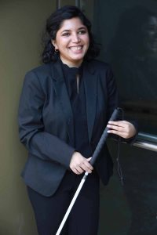
Treat People with Disabilities Respectfully
Acknowledge our differences as you would acknowledge anyone’s, but give us respect and agency, just like you would anybody else.
Do not talk down to us literally or figuratively.
Listen attentively and patiently to people who have trouble speaking - never pretend to understand if you don’t
Speak directly to the person with the disability not their interpreter, attendant or date.
Just because someone has a disability, do not assume they need help; Rather, ask and then respect their answer

Slide 13
Talk About Disability
Say the word. “Disability” is not a bad word!
Don’t use euphemisms like
“differently-abled” or “special needs.”
Use “non-disabled” instead of
“able-bodied” or “normal.”
Avoid passive, victim words.
Use accurate, respectful language.
Instead of “he suffers from cerebral palsy,” use “he has cerebral palsy.”
Eliminate common ableist language:
Ex: Crazy
Instead of “confined to a wheelchair” or “wheelchair-bound,” use “wheelchair user.”
Avoid referring to “the disabled” in the same way that you would avoid referring to “the Asians,” “the Jews” or “the African-Americans.” Instead, consider using such terms as “the disability community” or “the disability activist.”
Avoid “high-functioning” and “low-functioning” labels.
People with disabilities should not be described as “inspirational” or “courageous” just because they have a disability.
NCDJ Disability Language Style Guide: http://ncdj.org/style-guide/

Slide 14
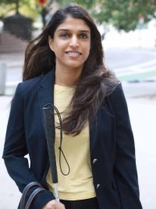
Language Matters
Some people prefer person-first language – “person with a disability" – and others prefer identity-first language – “disabled person”
  Community preferences
Avoid outdated terms like “handicapped,” “crippled,” or the “R” word
Ask the person what language they prefer and respect their preference
Just remember: Ask

Slide 15
Disability in the Criminal Legal System

Slide 16
Pathways in the System
Victimization
Accused of Crimes
First Contact/Investigation
Trial/Plea Agreement
Notification
Healing Services
First Contact/Investigation
Trial/Plea Agreement
Incarceration/Community Supervision
Transition/Reentry

Slide 17
In the Chat:
What challenges do you think individuals with disabilities face in moving through the criminal legal process?

Slide 18
Common Barriers
Attitudinal* – stigmas, stereotypes, and bias
Physical – built environments were not made for the disabled community
Communication – not sharing information in ways that can be easily understood
Environmental – systems, cultures, and practices were constructed without disability in mind
Policy and programmatic – landscape of existing laws, programs, and services
Socioeconomic – limited access to educational and employment opportunities/more likely to live in poverty

Slide 19
Disability Advocacy:
Breaking Down Barriers
Individuals with Disabilities Education Act (IDEA)
  Child find
  Free and appropriate education (FAPE)
  Individualized education programs (IEPs)
Rehabilitation Act of 1973
  Anti-discrimination
Americans with Disabilities Act (ADA) of 1990
  Anti-discrimination
  ADA Coordinators (Title II) – any public entity with 50+ employees

Slide 20
Rights and Responsibilities
Rights
  Effective communication
  Access to programs and services
Responsibilities: Anti-Discrimination
  Auxiliary aids and services
  Reasonable accommodations

Slide 21
Initial Considerations
Does disability even matter?​
  Start like any other case or matter
Asking about disability​
  Cannot and should not ask directly ​
How do I work with a guardian or other supporters?​
How do I communicate with the person?​
Do I need an expert witness with knowledge about the person’s disability? ​
What is the impact of the disability on the potential remedy/outcome?

Slide 22
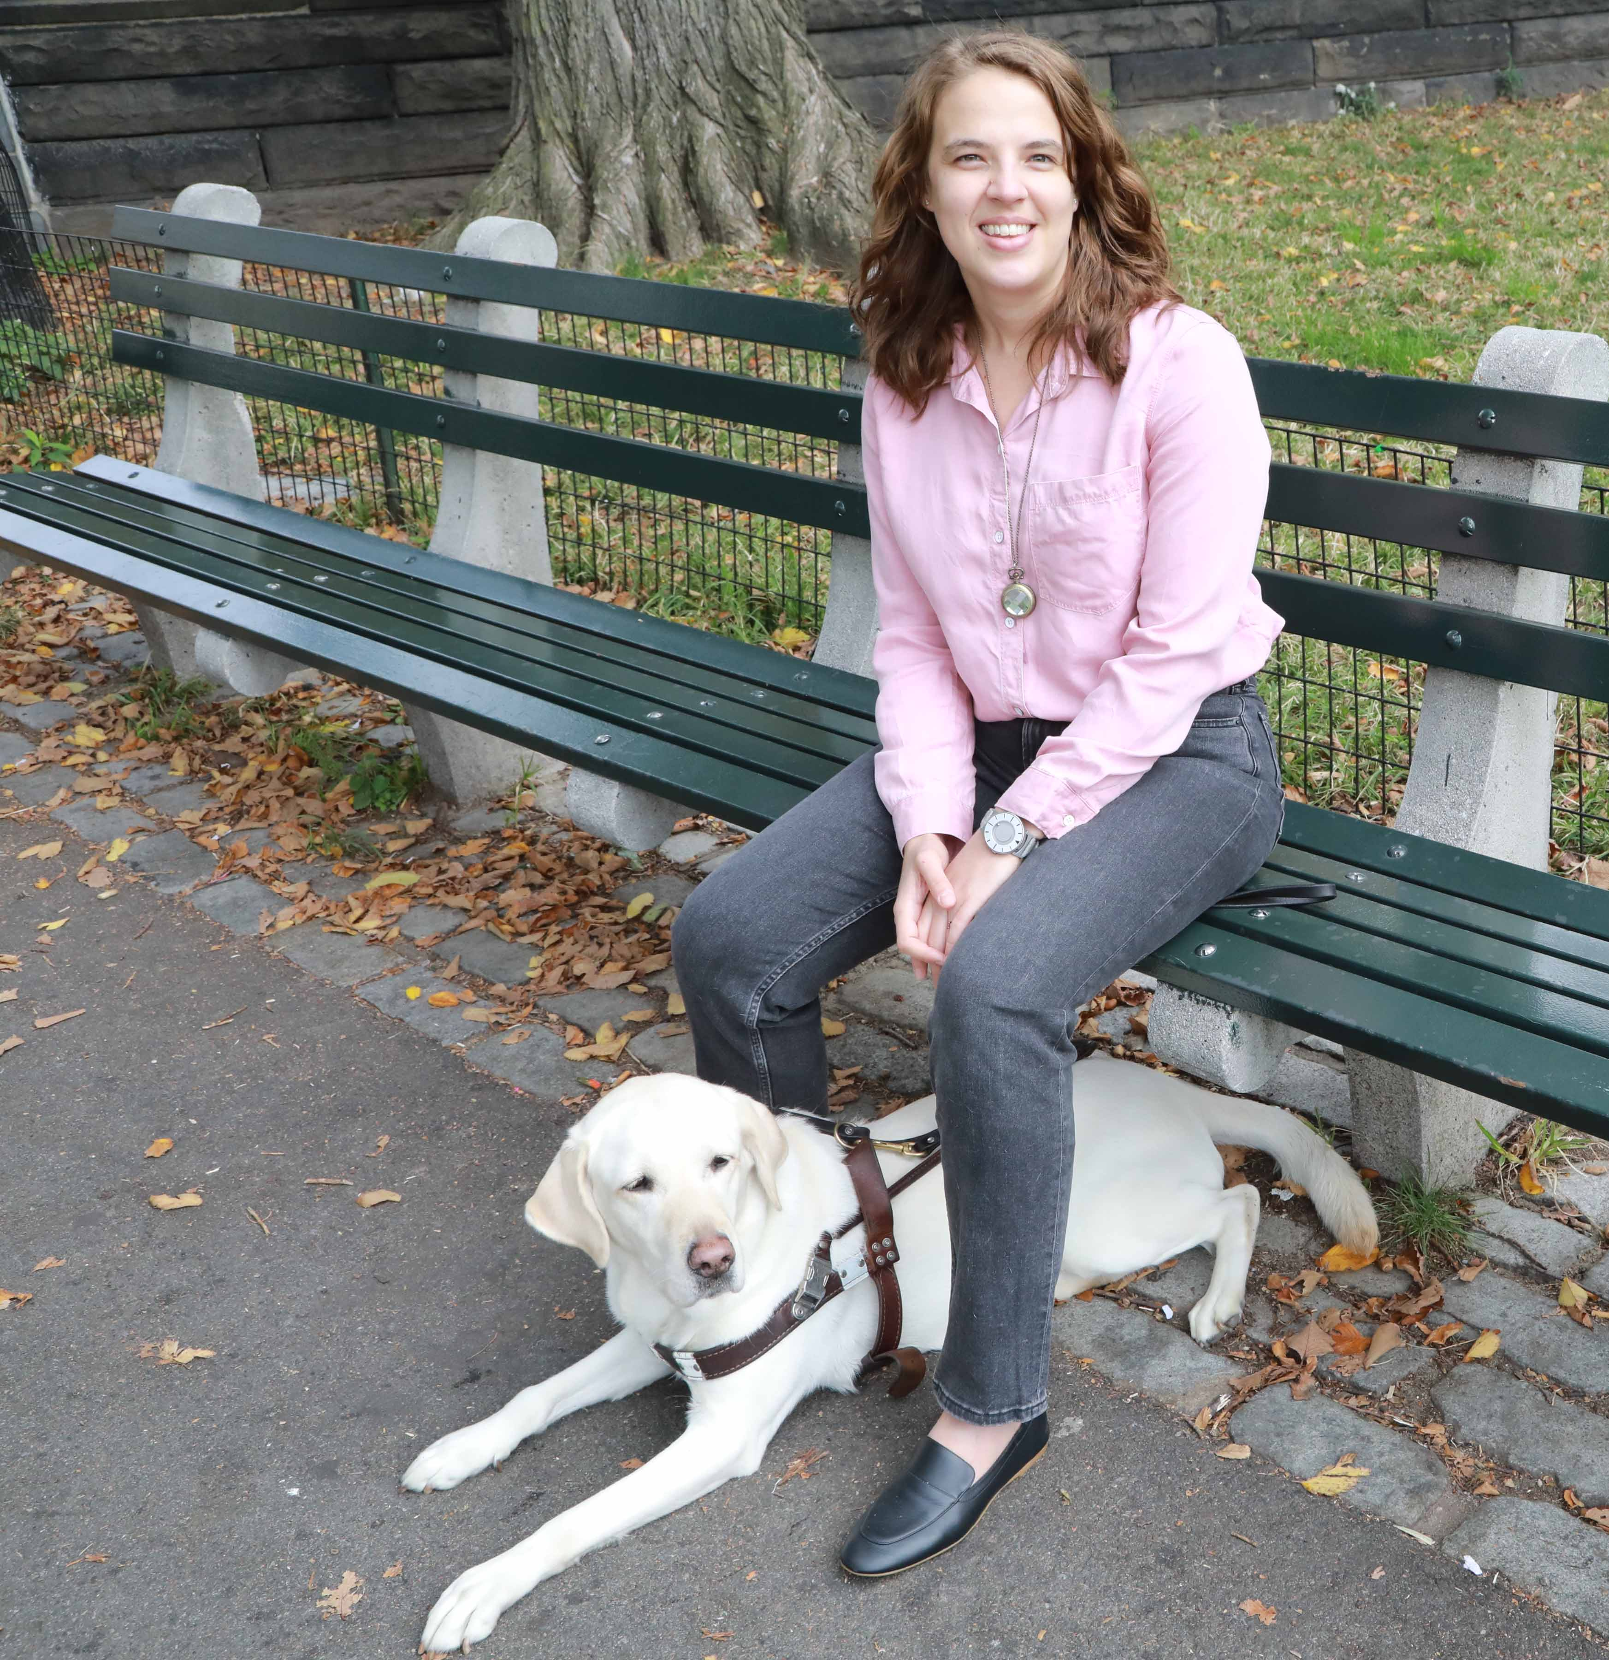
Recognize Your Own Implicit Bias
Major studies have found that people with disabilities are most often viewed through the lens of what we cannot do.
Are you biased against disabled people?
  You can find out through Project Implicit
Notes:
https://implicit.harvard.edu/implicit/takeatest.html
https://news.harvard.edu/gazette/story/2022/01/why-disability-bias-is-a-particularly-stubborn-problem/

Slide 23
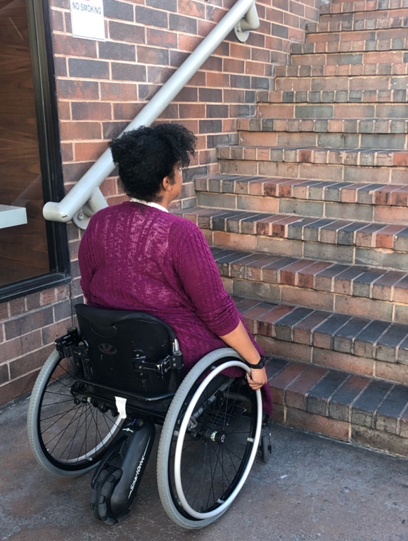
Recognize Ableism:
What Can You Do?
When you enter a building that does not have a doorway or bathroom accessible to someone who uses a wheelchair, do you recognize it as an ableist choice, and advocate for a solution?
When a virtual public meeting is happening over Zoom without free instant captioning turned on – so people who are Deaf and/or hard of hearing can participate – do you ask them to click on the button to enable accessibility?
Once you look for ableism, you will realize it is everywhere.
Recognizing it is the first step to dismantling it.

Slide 24
Access and Communication

Slide 25
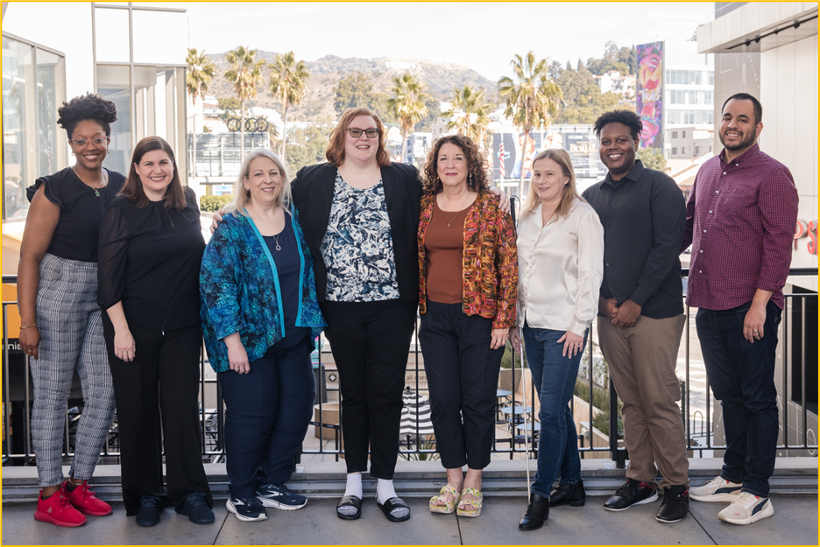
Partner with and Learn from Groups Led by People with Disabilities
People with disabilities know what solutions work for them!
Now we must be much more intersectional, get past the medical model of disability, and move toward a model that focuses on inclusivity, intersectionality, and eliminating the barriers created by societal choices
These solutions must be led by people with diverse identities, backgrounds, and disabilities

Slide 26
Make It Accessible
If something is accessible, your target audience can:
  Participate
  Understand
  Engage or take action
Common types of access needs
  Physical/mobility access
  Sensory access (auditory, visual, olfactory, and environmental stimulation)
  Cognitive access
  Communication access, including language considerations

Slide 27
Start from Universal Design
Originated in architecture/physical design
  Now adapted for many fields
7 key principles
  Equitable use
  Flexible use
  Simple and intuitive use
Perceptible information
Tolerance for error
Low physical effort
Size and space for approach/use

Slide 28
Meeting Individual Needs
If something is accessible, your target audience can:
  Participate
  Understand
  Engage or take action
Meeting individual needs
  Reasonable accommodations/modifications
  Auxiliary aids and services

Slide 29
Effective Communication
Effective communication
  Communication with persons with disabilities that is just as effective as with persons without disabilities
Communication disabilities
  Disabilities that impact seeing, hearing, speaking, writing, reading, understanding or any other trait or activity required for communicating

Slide 30
Legal Responsibilities
Provide auxiliary aids and services to individuals with disabilities, typically upon request
  But be prepared to do so ahead of time
Both written and face-to-face communication
Primary consideration must be given to the individual’s choice of aid or service
Make information available about accessible services, activities, and facilities

Slide 31
Auxiliary Aids and Services
Devices or services that enable effective communication for people with disabilities
Examples
  Qualified interpreters
  Screen readers
  Videotext displays
  Assistive listening devices
  Captioning/CART services
  Text-to-speech software

Slide 32
Examples
Individual who is blind – needs to complete forms
  Possible auxiliary aids and services: qualified reader; screen reader/digital forms; Braille materials
Individual who is hard of hearing – needs to be interviewed
  CART; assistive listening device; ASL interpreter
Individual with intellectual disability – needs to review a restitution agreement
  Plain language version; explanation; support person

Slide 33
Asking the Right Questions
As we work together, there will be a lot of forms and documents. Is there anything I can do to help you better read or understand these documents?​
There may be a lot of complex legal terms and words that we might use. What is the best way for me to explain these words?​
There may be times when you need something to participate in our program/service. What is the easiest way for you to ask for what you might need?

Slide 34
Communication Tips
Learn how the person best communicates​
Limit distractions (e.g., no hallway discussions)​ and find an environment where the person feels comfortable​
Be patient and willing to repeat information ​
Use visual or other communication aids ​
Check for understanding
Modify common forms (e.g., enlarge fonts (14+); simplify legal jargon)
Discuss appropriate courtroom behavior and attire in detail—consider using a social story​
Communicate lengths of time in a concrete way​
Simplify complex words or phrases without destroying meaning​

Slide 35

Continue Your Disability Inclusion Journey
Continue your learning with RespectAbility’s Disability Training & Speakers Bureau:
Disability 101: Ensuring Best Practices in Disability Inclusion
Best Practices: Recruitment and Retention
Creating a Welcoming, Inclusive and Accessible Organization
Ensuring Accessible In-Person and Virtual Events
Living with a Disability in an Inaccessible World
Mental Health & Wellness in the Workplace
Disability Inclusion in Philanthropy
Email JakeS@RespectAbility.org for more information

Slide 36
Equity and Access Webinar Series
Disability 101
Disability History
How to Ensure Accessible Events
How to Recruit, Accommodate and Promote People with Disabilities for Paid Employment, Volunteer Leadership and Board Positions
How to Ensure A Welcoming Lexicon and Inclusive Storytelling
How to Ensure Accessible Websites, Social Media and Inclusive Photos
Premium Skills Workshop in Social Media Accessibility
How to Ensure Legal Rights and Compliance Obligations
Watch Recordings, Download Transcripts and PowerPoints:
https://www.respectability.org/accessibility-webinars/

Slide 37
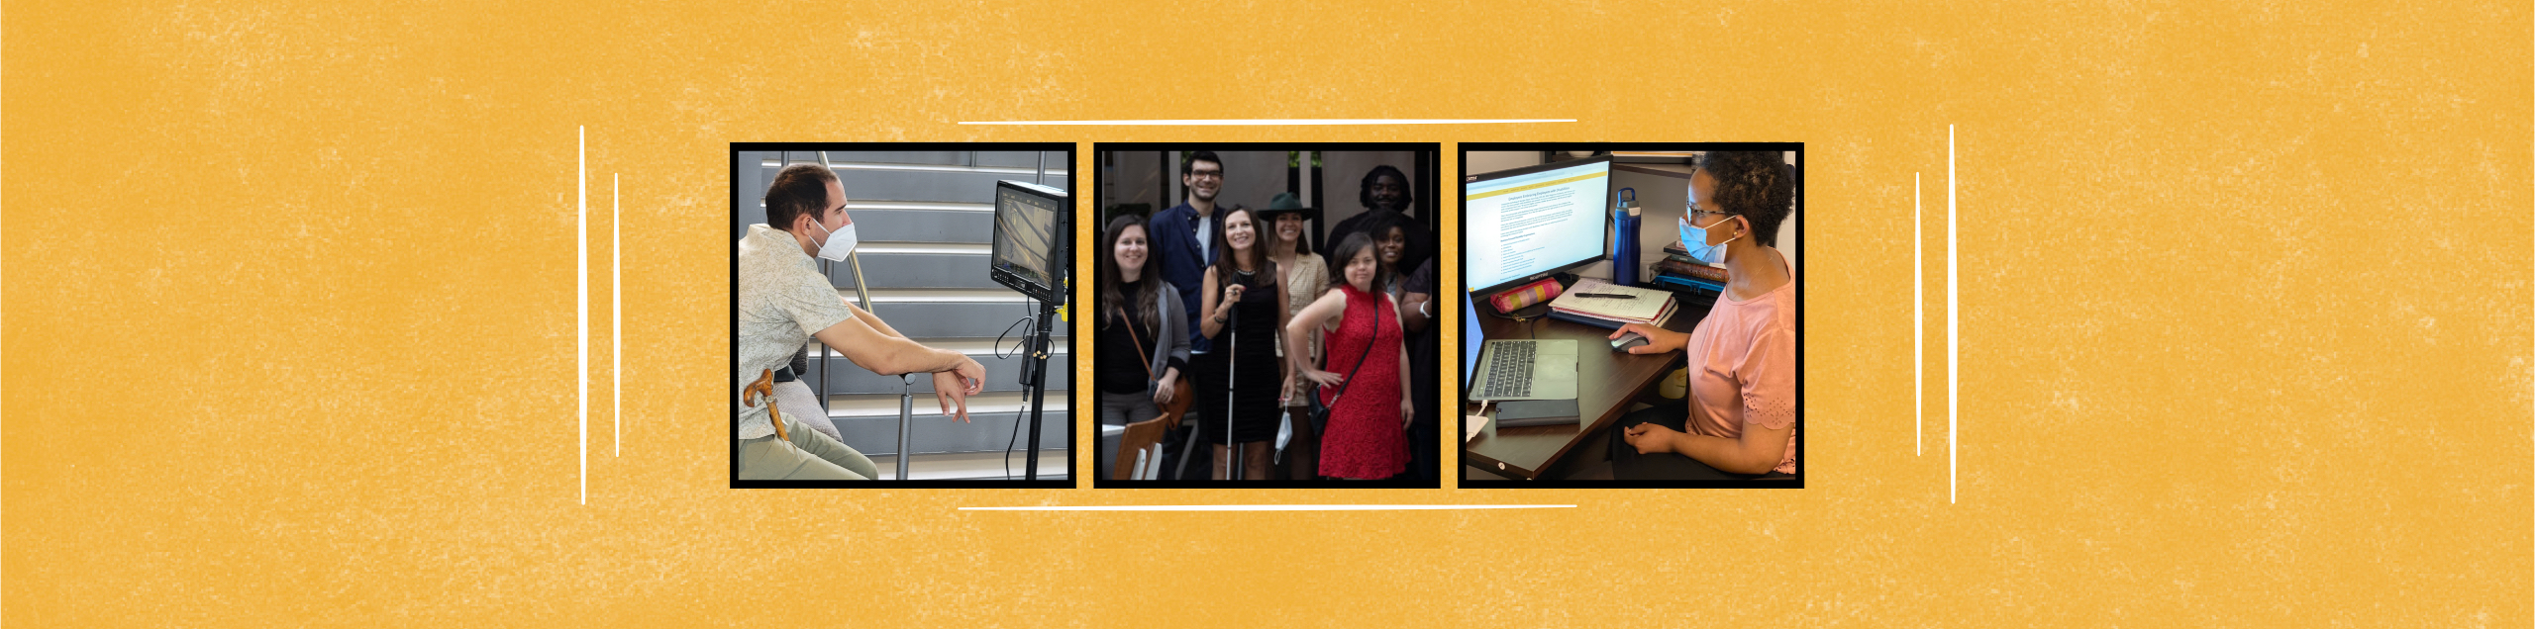
FOR MORE INFORMATION
Ariel Simms, President and Chief Executive Officer, ArielS@RespectAbility.org
Graciano Petersen, Senior Director of Talent, Culture and Training at RespectAbility: GracianoP@RespectAbility.org
Jake Stimell, Disability Training & Consulting Bureau Associate: JakeS@RespectAbility.org

